Slide 1
Sports Injuries and Physiotherapy
इंदिरा गााँधी राजकीय स्नातकोत्तर महादिद्यालय, बांगरमऊ, उन्नाि (उ.प्र.)
Indira Gandhi Government P. G. College (U.P.) (Accredited By NAAC)
Dr. Vishnu Mishra
(Principal & Associate Prof.)

Slide 2
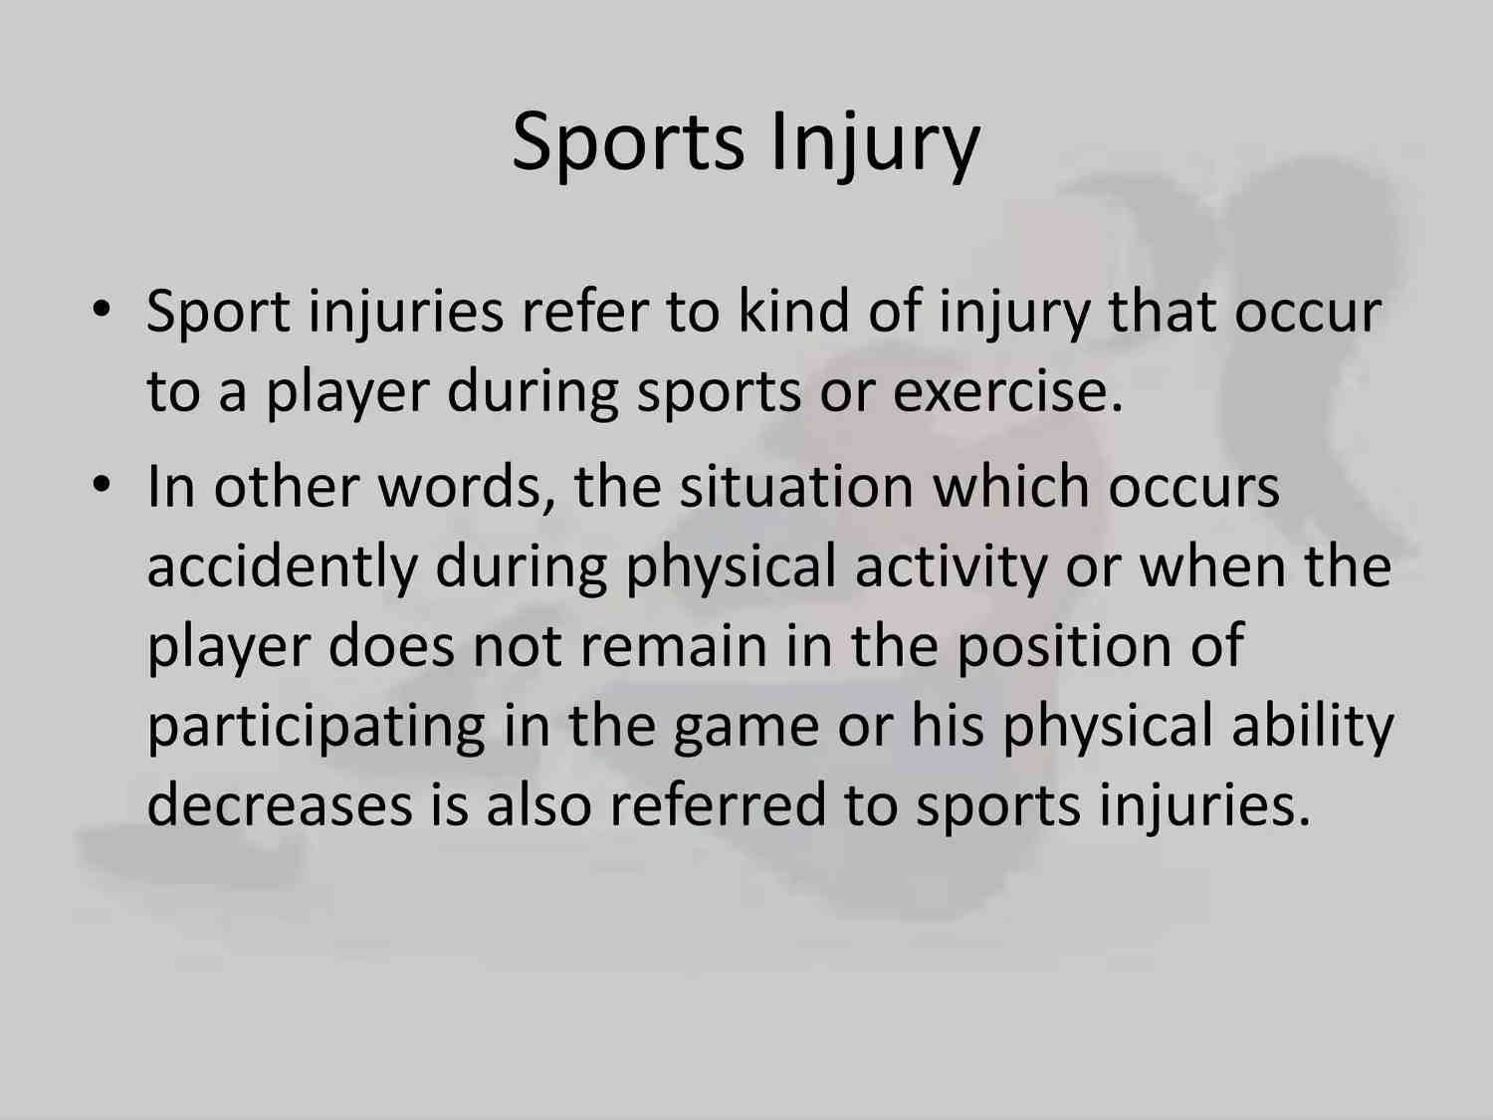

Slide 3
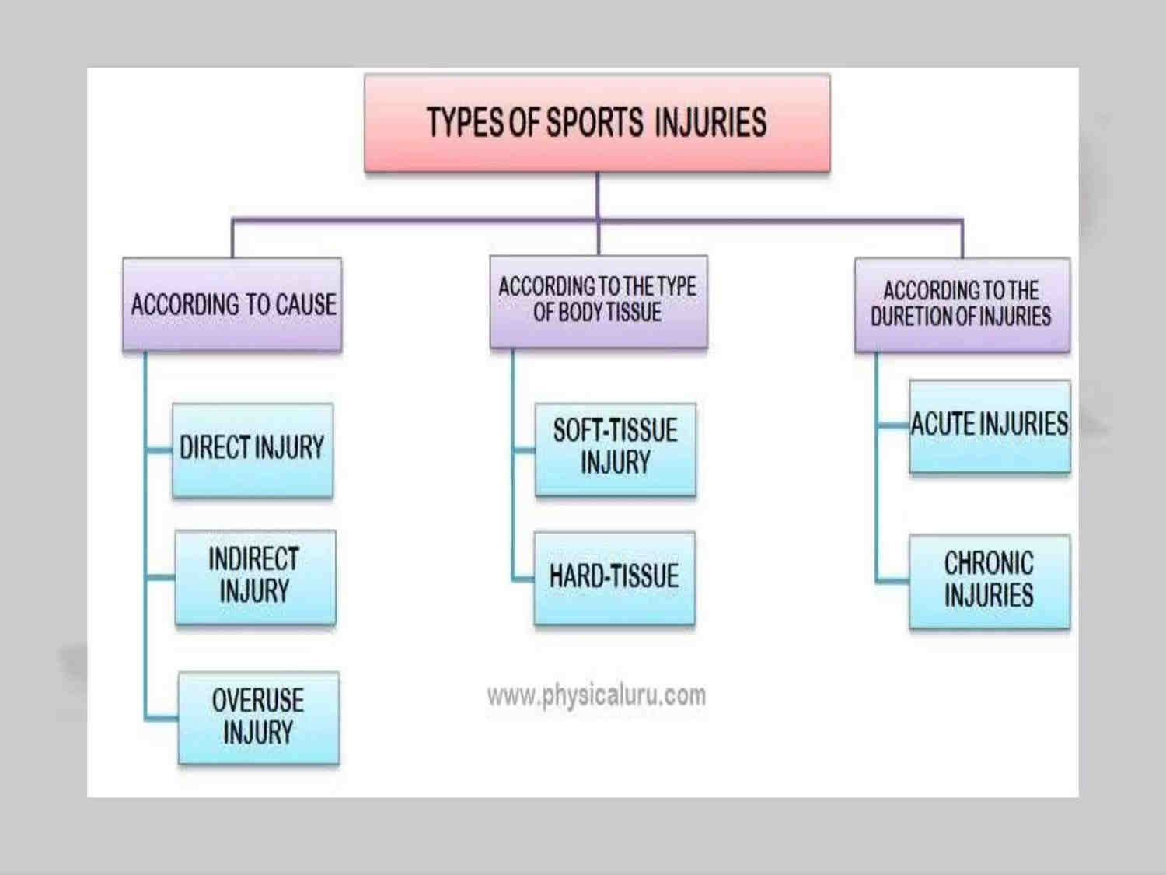

Slide 4
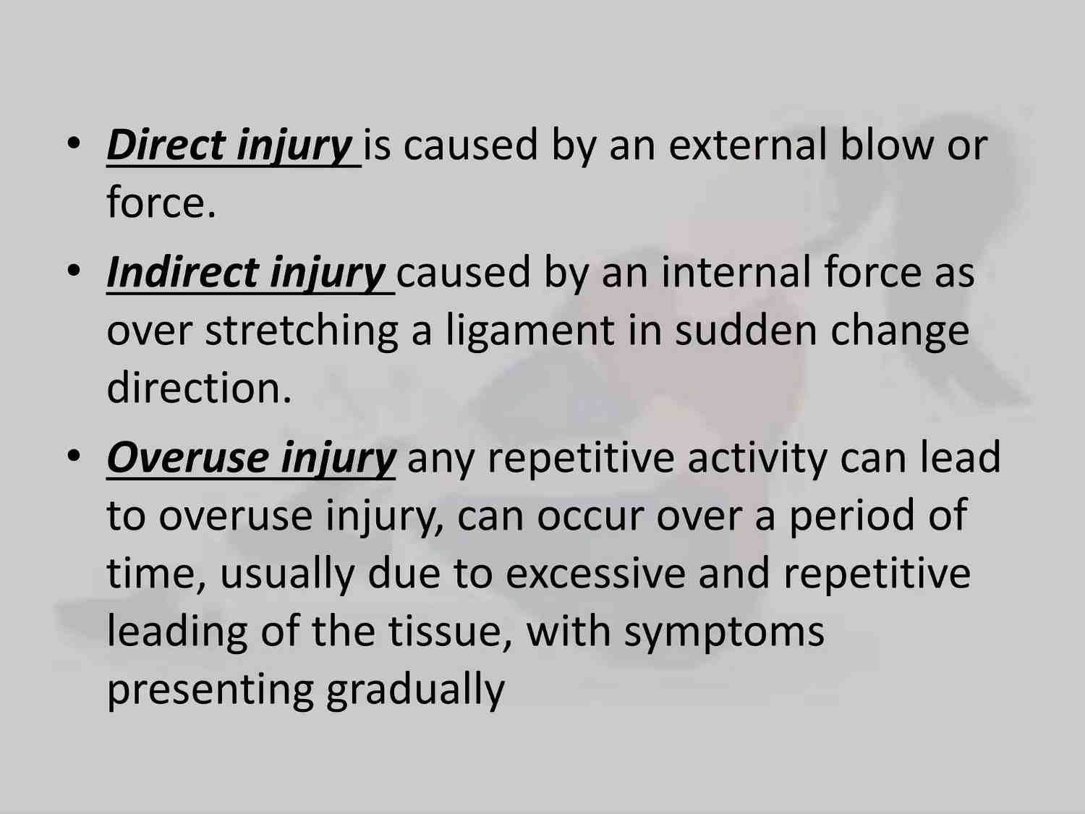

Slide 5
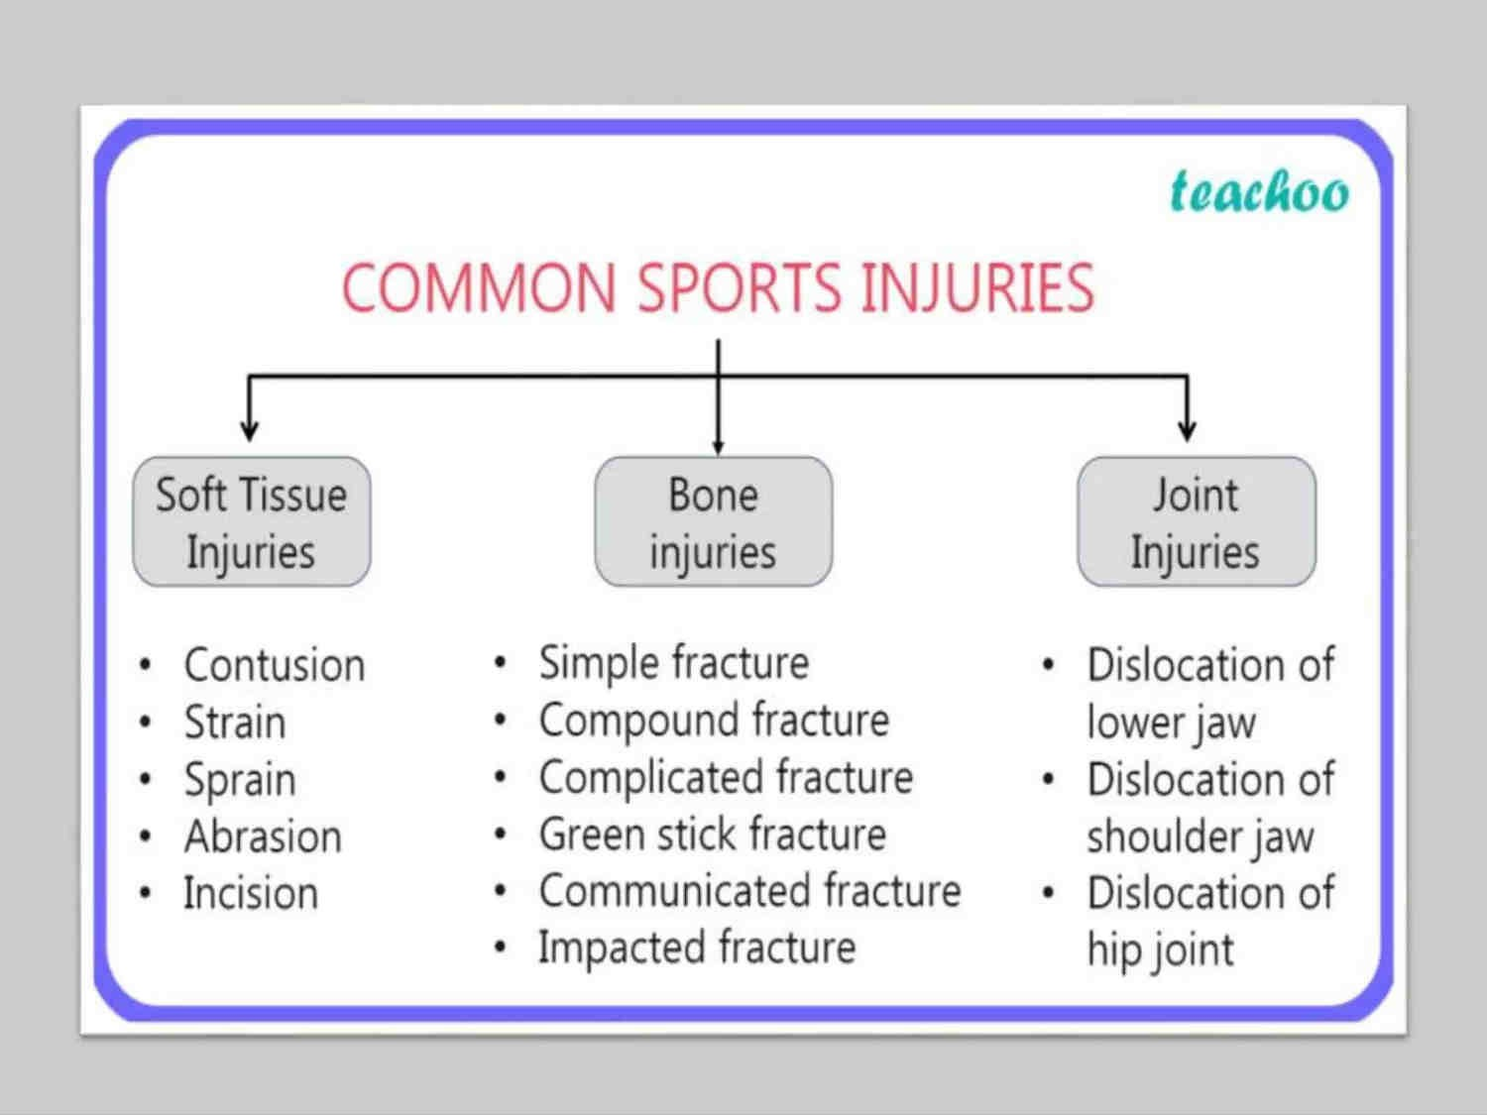

Slide 6
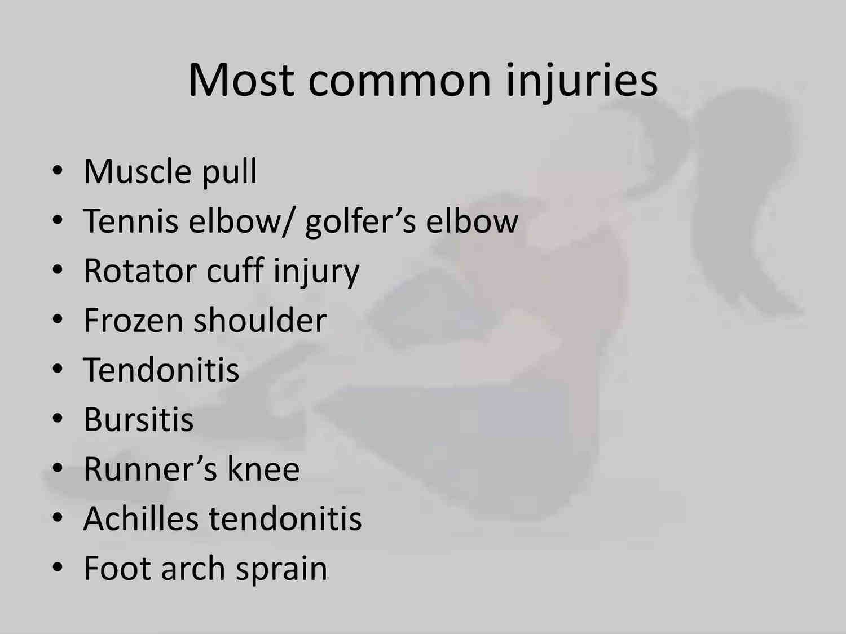

Slide 7
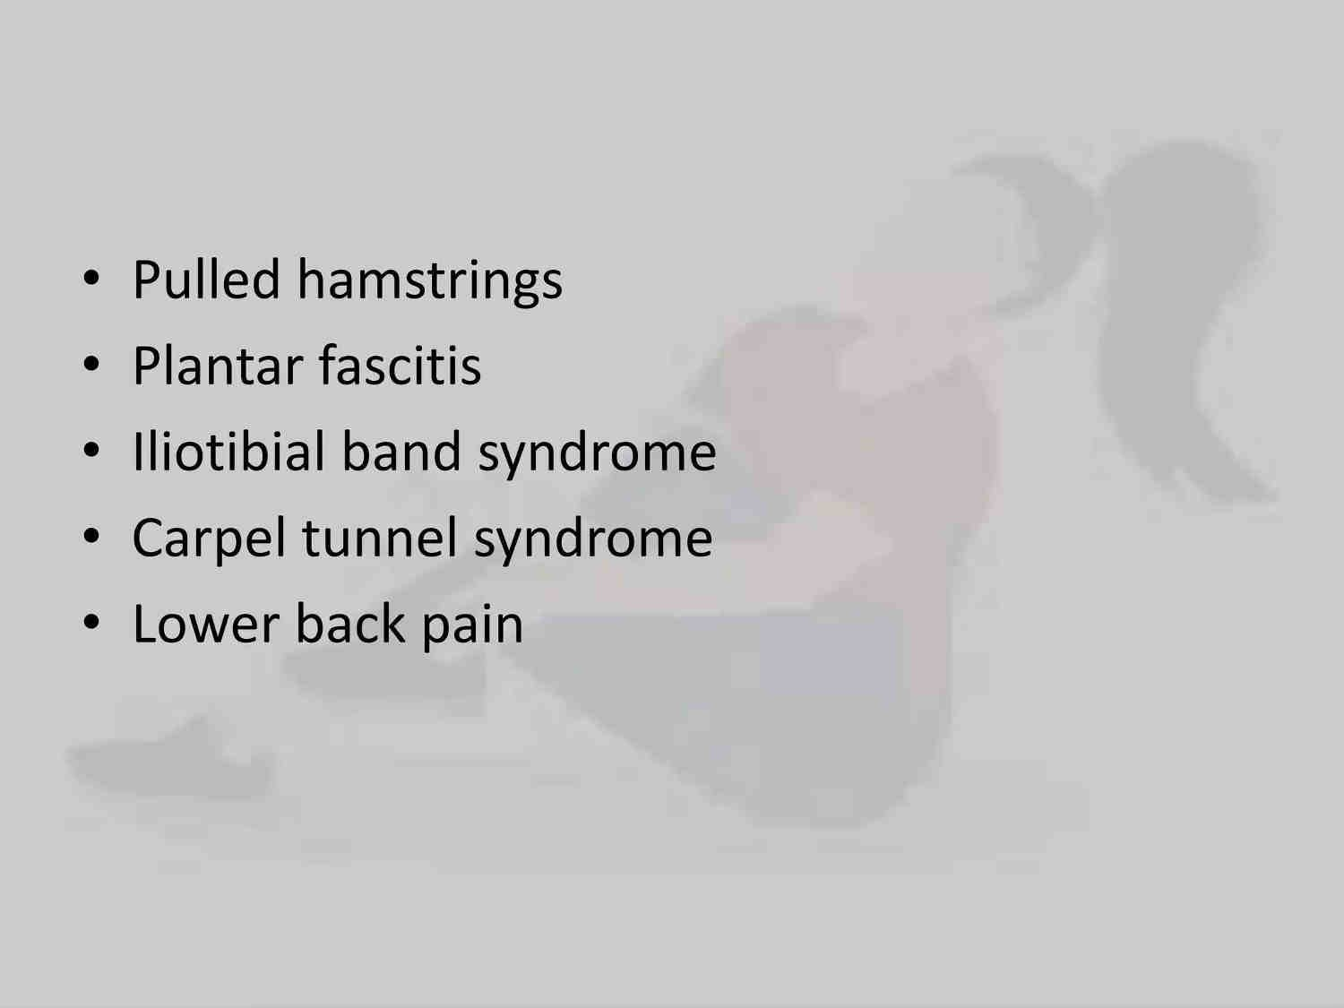

Slide 8
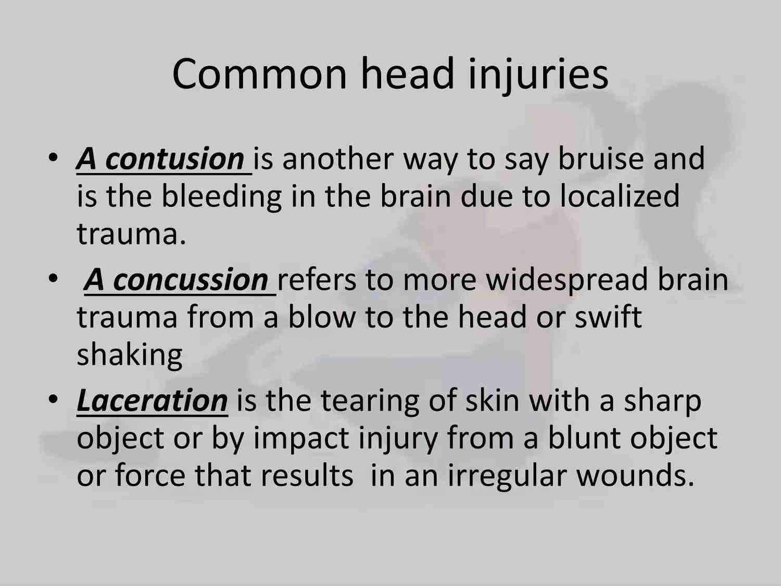

Slide 9
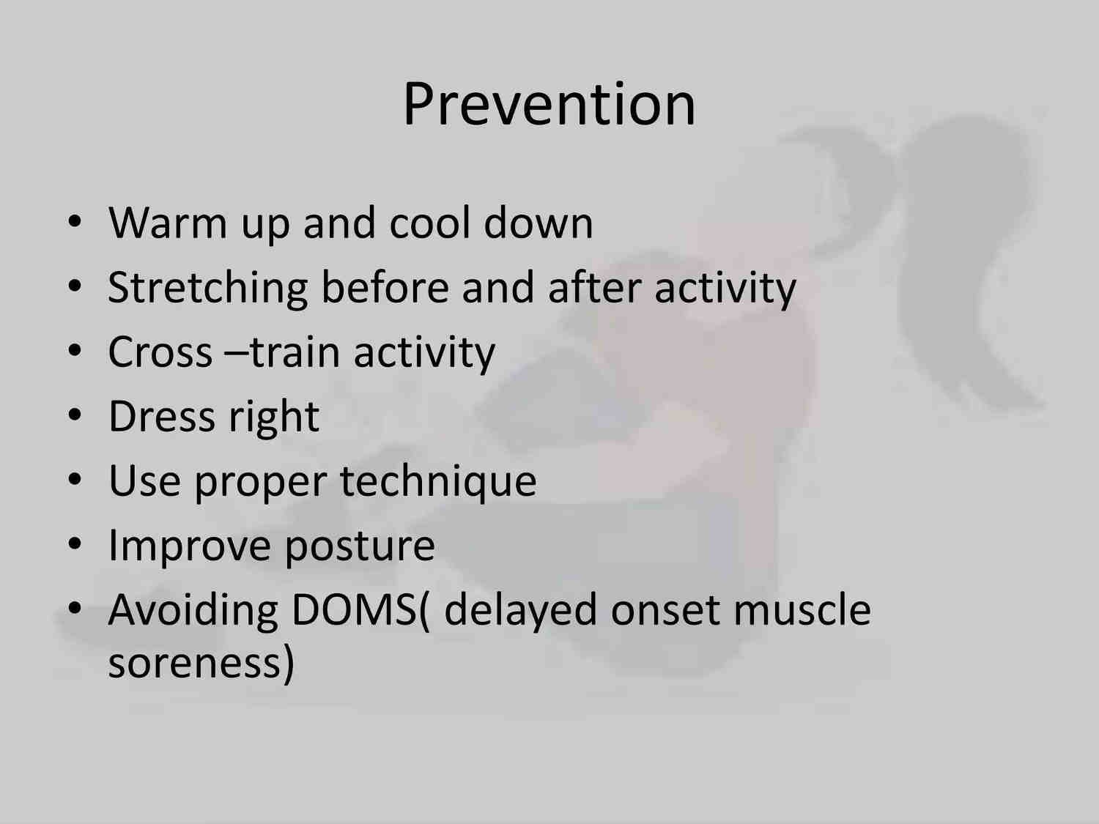

Slide 10
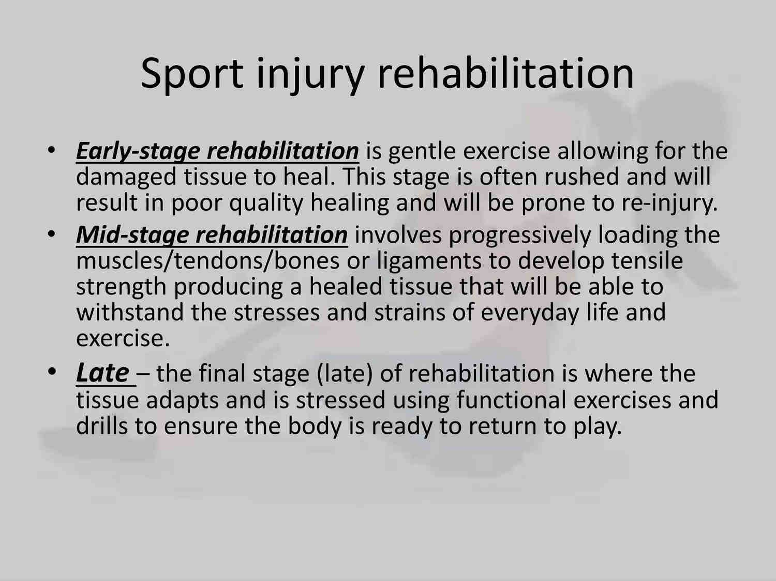

Slide 11
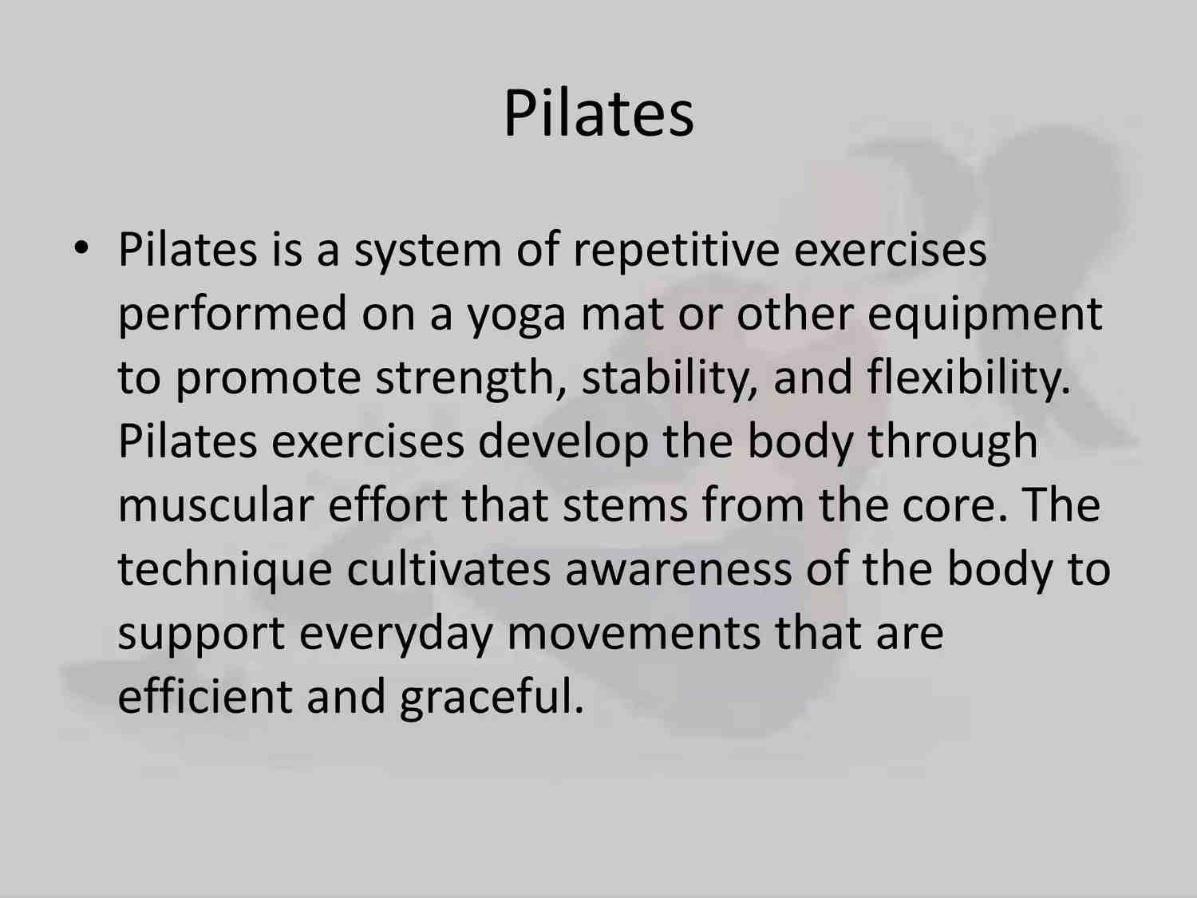

Slide 12
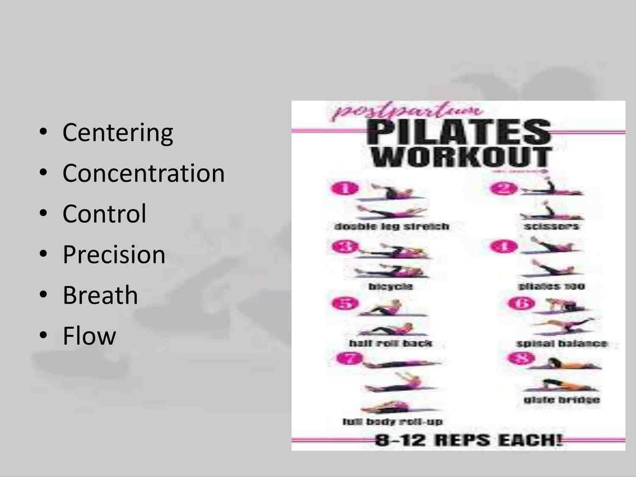

Slide 13
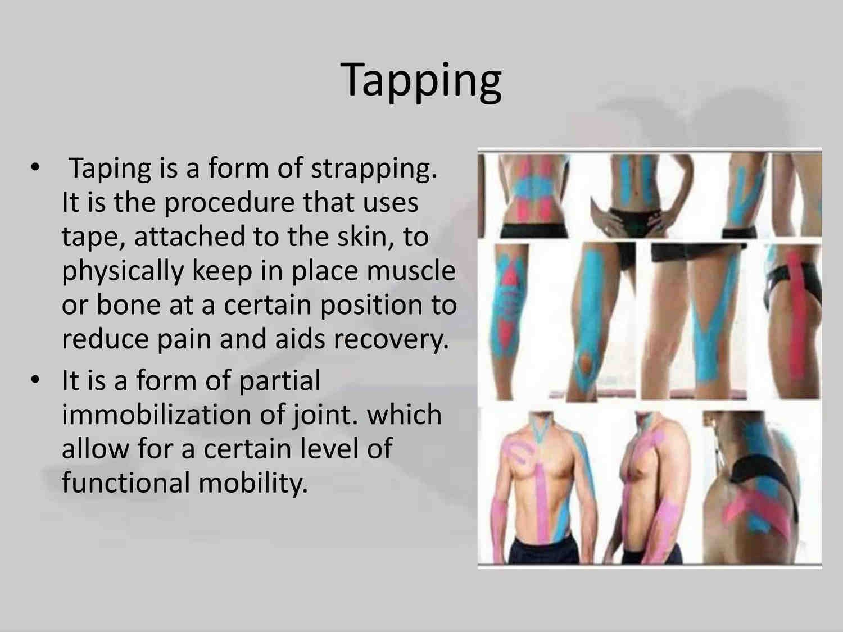

Slide 14
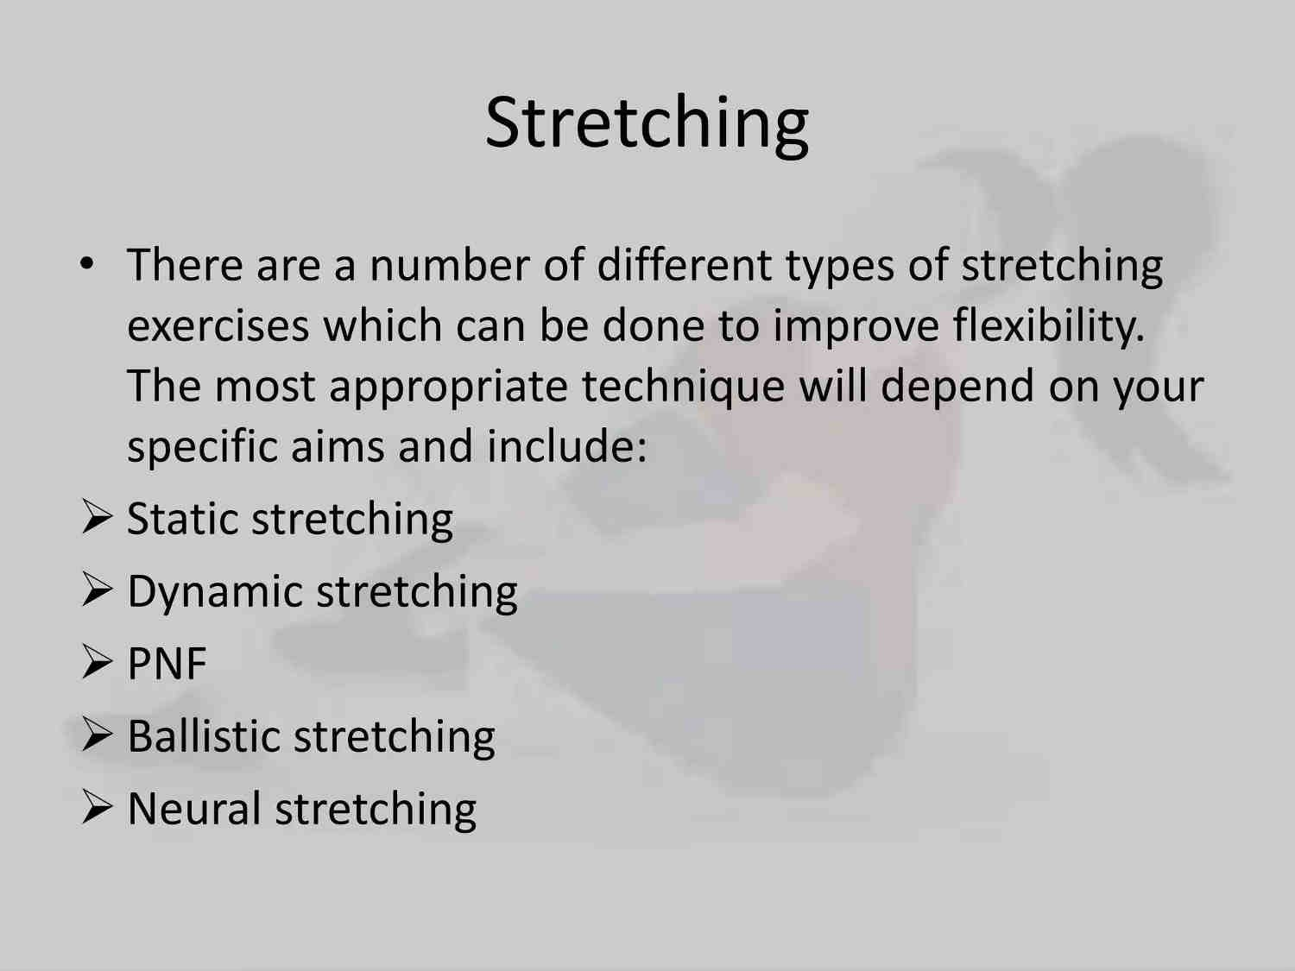

Slide 15
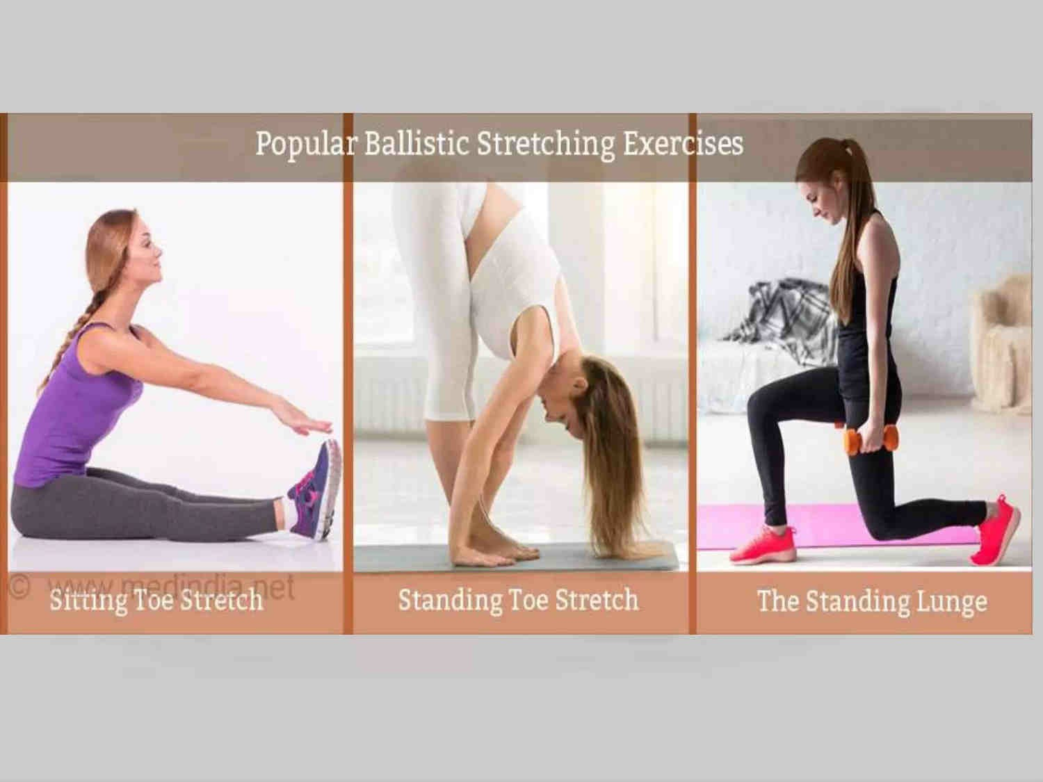

Slide 16
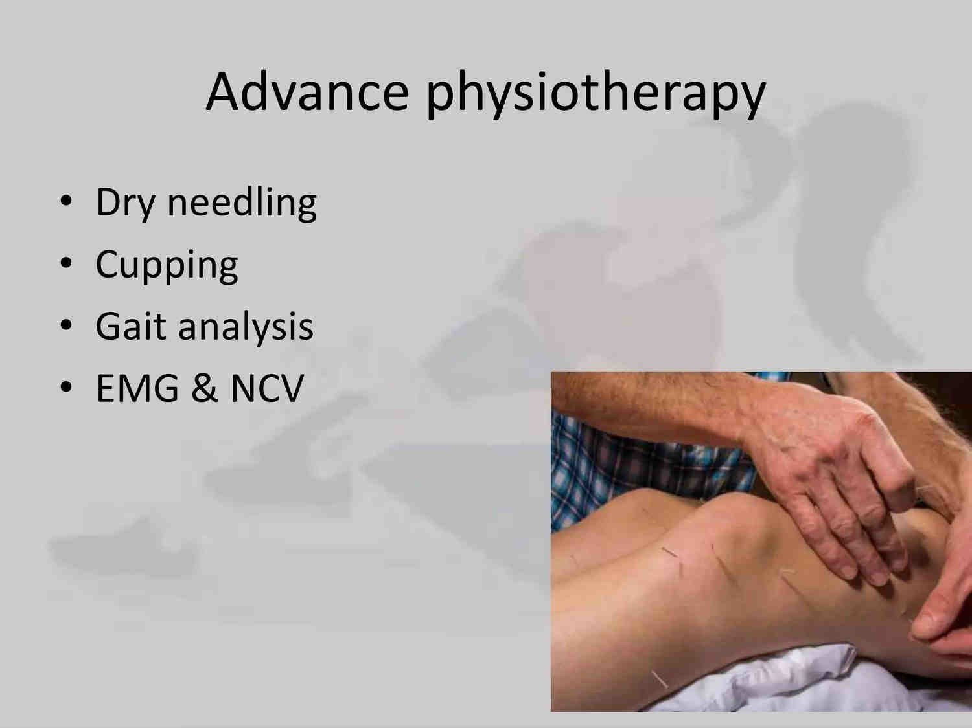

Slide 17


